Slide 1
increasing transparency through a multiverse analysis
wolf vanpaemel
university of leuven
with sara steegen, francis tuerlinckx and andrew gelman
BAPS
symposium on practical Solutions for improving open science and research integrity
may 18th 2018
ghent

Slide 2
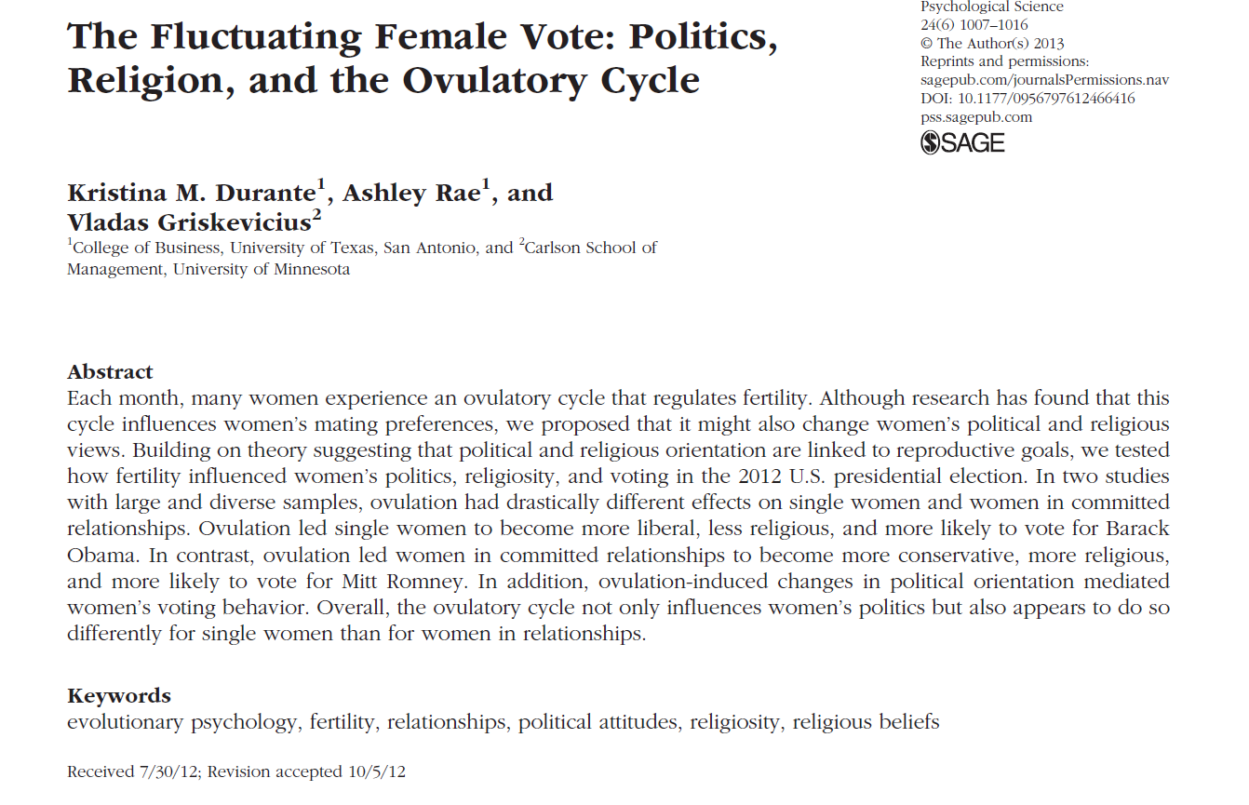

Slide 3
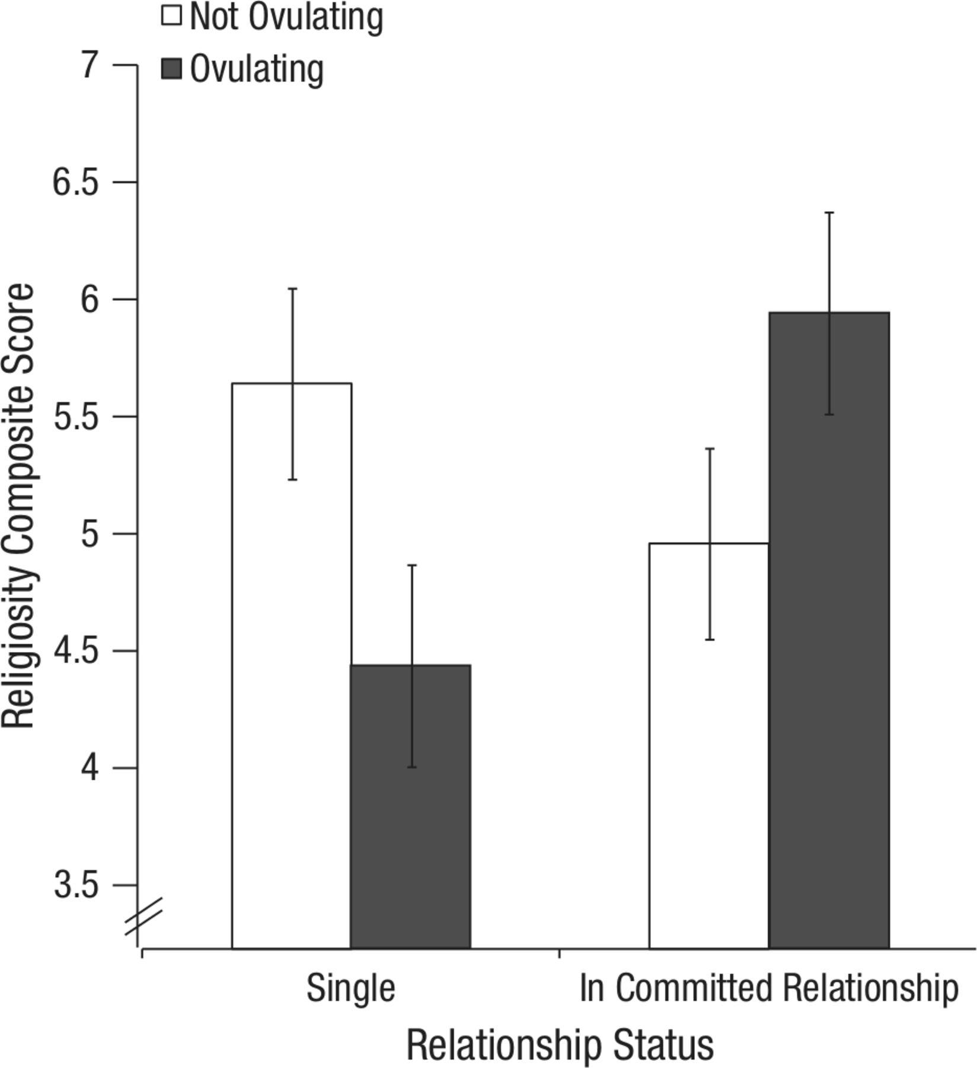
women’s religiosity as a function of fertility and relationship status
fertility x relationship status interaction,
F(1,159)=6.46, p=.012

Slide 4
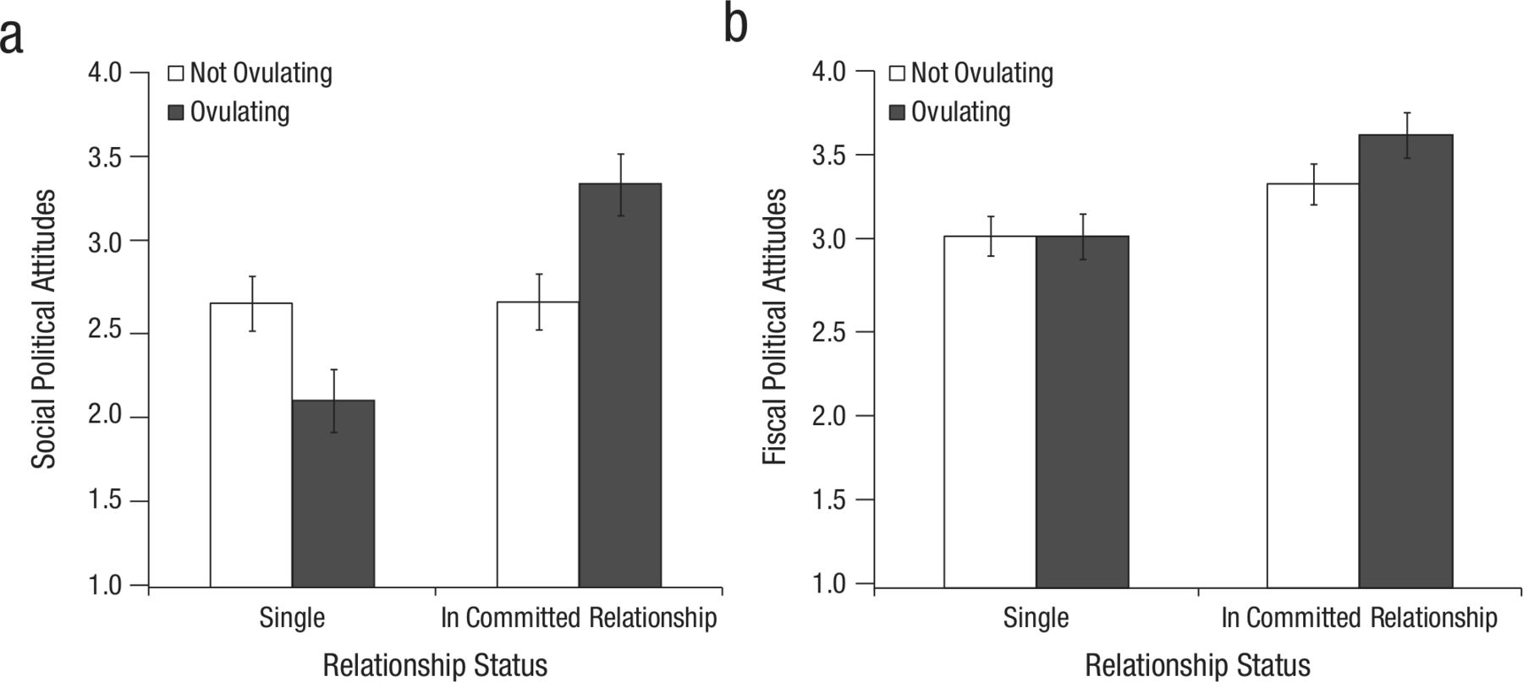
women’s social political attitudes (conservatism) as a function of fertility and relationship status
fertility x relationship status interaction, F(1,299)=12.26, p=.001

Slide 5
there are nice things to say about this study
relatively large sample size (275 in study 1, 502 in study 2)
attempt to relate the finding to (evolutionary) theory
the p-values are computed (mostly) correctly
in-paper replication of study 1
open data (on request, and now publically on https://osf.io/zj68b/)
it is used as a cautionary tale about
the impact arbitrary data processing choices have on statistical conclusions
the importance of assessing the analytical robustness of findings

Slide 6
analyses are based on the following data
fertility status (high vs low)
relationship status (single vs committed)
religiosity score (first example) or social political attitudes score (second example)
these data were not just “collected” or “observed”
the data were constructed

Slide 7
the observed, raw data include
answer to three statements on religiosity and five statements on social political attitudes (e.g., on abortion, marijuana, etc)
answer to a bunch of fertility related questions
the start of the last period
the start date of the period before the last period
the typical cycle length
the start of the next period
how sure are you about the start of the last period
how sure are you the start date of the period before the last period
answer to “what is your current romantic relationship status?”
(1) not dating/romantically involved with anyone
(2) dating or involved with only one partner
(3) engaged or living with my partner
(4) married

Slide 8
the original constructed data set
translating the observed, raw data to the processed data ready for analysis involved several choices
fertility status?
answer to fertility related questions
the start of the last period
the start date of the period before the last period
the typical cycle length
the start of the next period
how sure are you about the start of the last period
how sure are you the start date of the period before the last period
high in fertility when cycle day is between 7 and 14
low in fertility when cycle day is between 17 and 25
cycle length →
next menstrual
onset → cycle day

Slide 9
relationship status?
answer to “what is your current romantic relationship status?”
(1) not dating/romantically involved with anyone
(2) dating or involved with only one partner
(3) engaged or living with my partner
(4) married
single
committed

Slide 10
there’s nothing wrong with constructing data per se
the problem is that in data construction there are often several reasonable options to choose from
researcher degrees of freedom (simmons, nelson & simonsohn, 2011, wicherts et al., 2016) and the garden of forking paths (gelman & loken, 2014)
let’s have a look at the other reasonable options

Slide 11
other reasonable data sets
fertility status?
answer to fertility related questions
the start of the last period
the start date of the period before the last period
the typical cycle length
the start of the next period
how sure are you about the start of the last period
how sure are you the start date of the period before the last period
cycle length →
next menstrual
onset → cycle day

Slide 12
fertility status?
answer to fertility related questions
the start of the last period
the start date of the period before the last period
the typical cycle length
the start of the next period
how sure are you about the start of the last period
how sure are you the start date of the period before the last period
next menstrual
onset → cycle day

Slide 13
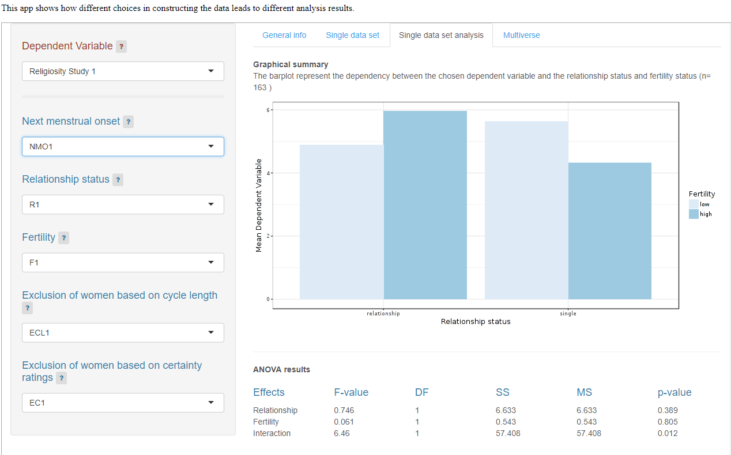

Slide 14
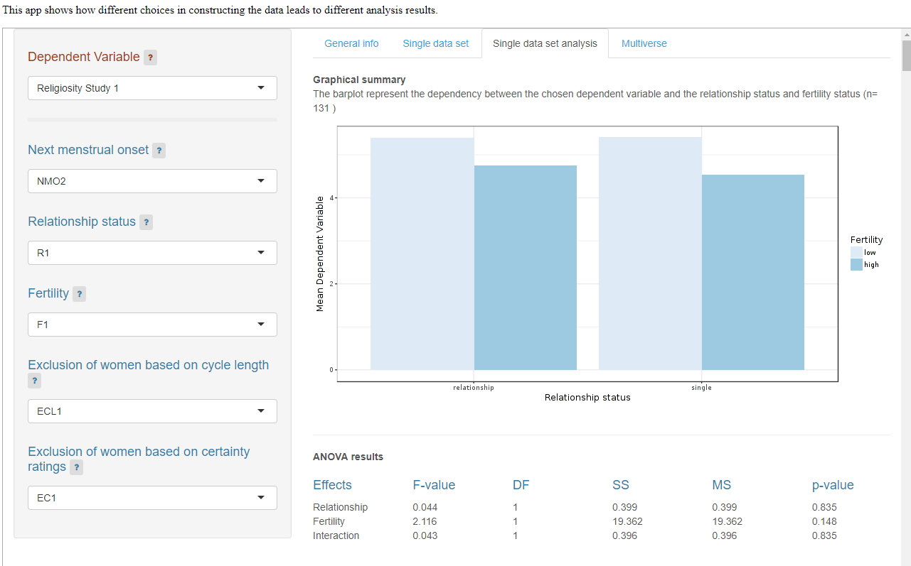

Slide 15
fertility status?
answer to fertility related questions
the start of the last period
the start date of the period before the last period
the typical cycle length
the start of the next period
how sure are you about the start of the last period
how sure are you the start date of the period before the last period
cycle day

Slide 16
fertility status?
answer to fertility related questions
the start of the last period
the start date of the period before the last period
the typical cycle length
the start of the next period
how sure are you about the start of the last period
how sure are you the start date of the period before the last period
high in fertility when cycle day is between 7 and 14
low in fertility when cycle day is between 17 and 25
cycle length →
next menstrual
onset → cycle day

Slide 17
fertility status?
answer to fertility related questions
the start of the last period
the start date of the period before the last period
the typical cycle length
the start of the next period
how sure are you about the start of the last period
how sure are you the start date of the period before the last period
high in fertility when cycle day is between 6 and 14
low in fertility when cycle day is between 17 and 27
durante et al., 2011
cycle length →
next menstrual
onset → cycle day

Slide 18
fertility status?
answer to fertility related questions
the start of the last period
the start date of the period before the last period
the typical cycle length
the start of the next period
how sure are you about the start of the last period
how sure are you the start date of the period before the last period
high in fertility when cycle day is between 9 and 17
low in fertility when cycle day is between 18 and 25
durante et al., 2012
cycle length →
next menstrual
onset → cycle day

Slide 19
fertility status?
answer to fertility related questions
the start of the last period
the start date of the period before the last period
the typical cycle length
the start of the next period
how sure are you about the start of the last period
how sure are you the start date of the period before the last period
high in fertility when cycle day is between 8 and 14
low in fertility when cycle day is between 1 and 7 or 15 and 28
durante et al., 2014
cycle length →
next menstrual
onset → cycle day

Slide 20
fertility status?
answer to fertility related questions
the start of the last period
the start date of the period before the last period
the typical cycle length
the start of the next period
how sure are you about the start of the last period
how sure are you the start date of the period before the last period
high in fertility when cycle day is between 9 and 17
low in fertility when cycle day is between 1 and 8 or 18 and 28
durante and arsena., 2015
cycle length →
next menstrual
onset → cycle day

Slide 21
relationship status?
answer to “what is your current romantic relationship status?”
(1) not dating/romantically involved with anyone
(2) dating or involved with only one partner
(3) engaged or living with my partner
(4) married
single
committed

Slide 22
relationship status?
answer to “what is your current romantic relationship status?”
(1) not dating/romantically involved with anyone
(2) dating or involved with only one partner
(3) engaged or living with my partner
(4) married
single
committed

Slide 23
relationship status?
answer to “what is your current romantic relationship status?”
(1) not dating/romantically involved with anyone
(2) dating or involved with only one partner
(3) engaged or living with my partner
(4) married
single
committed

Slide 24
who to include?
everybody, or only women who have regular cycle lengths?
the estimated cycle length
the reported cycle length
everybody, or only women who are reasonably sure about their start dates?

Slide 25
cycle day assessment (3 choice options)
fertility assessment (5 choice options)
relationship status assessment (3 choice options)
exclusion criteria based on cycle length (3 choice options)
exclusion criteria based on certainty (2 choice options)
all choices seem reasonable and have been used in other studies
if no clear justification can be given for a particular set of choices,
the choices are arbitrary
the data set constructed using the choices is arbitrary
the statistical result based on the data set is arbitrary

Slide 26
the multiverse
the raw data do not uniquely give rise to a single data set
each combination of choices gives rise to a separate data set
this leads to more than 100 reasonable data sets in this example
even after excluding inconsistent combinations
e.g., if reported cycle length is used in cycle day assessment, estimated cycle length is not used as an exclusion criterion
there is a multiverse of data sets, by (consistent) combinations of all reasonable data constructing choices
each data set from this multiverse gives rise to a statistical result on the effect of fertility
there is a multiverse of statistical results

Slide 27
the currently dominant practice involves selectively reporting a N=1 sample from the data multiverse, without justification
obvious problem: it hides the arbitrariness of the statistical result
obvious solution:
don’t report a single statistical result unless a clear justification for the specific choices in data construction can be given
instead, repeat the analysis of interest across the multiverse of data sets (i.e., for each possible combination of choices)
a multiverse analysis
provides a detailed picture of the robustness or fragility of statistical results
helps identifying key choices that conclusions hinge on

Slide 28
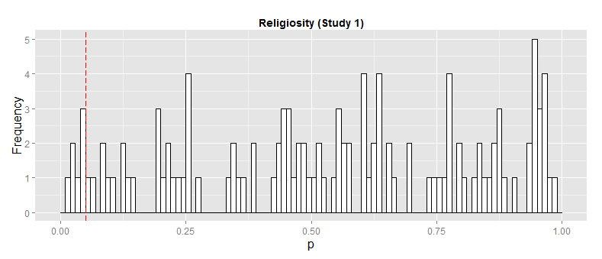
into the multiverse
6%
effect is too fragile to be taken seriously

Slide 29
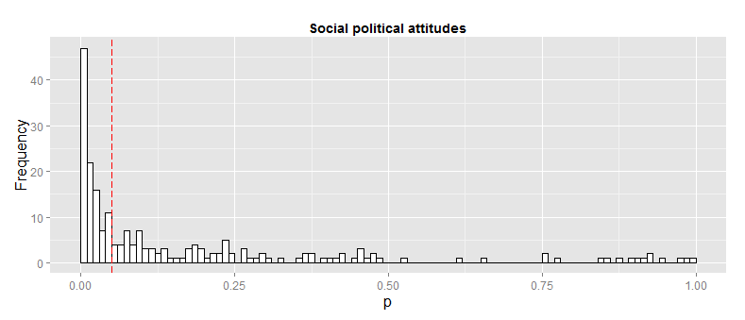
49%
the belief in the effect heavily depends on
the belief in the different processing choices

Slide 30
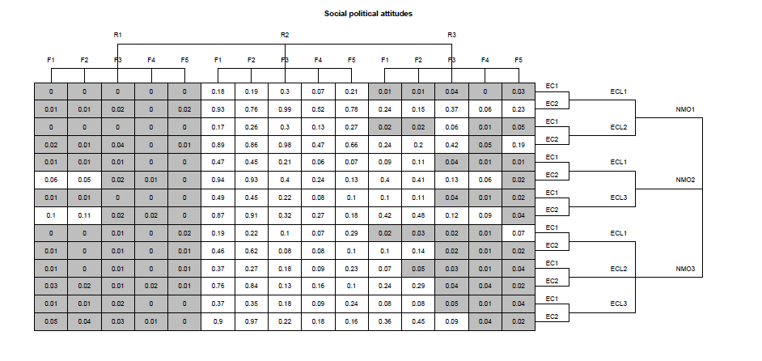
if you trust R1, there is evidence for a significant effect of fertility
if you trust R2, there is no evidence for a significant effect of fertility
if you trust R3, or have no reason to prefer certain choices
you are uncertain about the effect of fertility so you can’t draw a substantive conclusion about the effect of fertility
your only conclusion is a methodological one: the need to deflate the multiverse

Slide 31
deflating the data multiverse
reducing the number of arbitrary choices in data construction
better theory, e.g. on the relationship between cycle day and fertility
better measurement, e.g. better way of assessing fertility
surges in luteinizing hormone (e.g., durante et al., 2011)
better design, e.g., in assessing relationship status
dating or involved with only one partner is too ambiguous to be helpful

Slide 32
measuring aggressive behavior using the Competitive Reaction Time Task (CRTT)
participants are led to believe they play a computerized reaction time game against another participant in an adjacent room
at the beginning of each round, both participants set the intensity (volume and/or duration) of a noise blast
they have to react to a stimulus as quickly as possible by pressing a button
the slowest player of a round is punished with a noise blast using the intensity settings made by the fastest player
flexiblemeasures.com

Slide 33
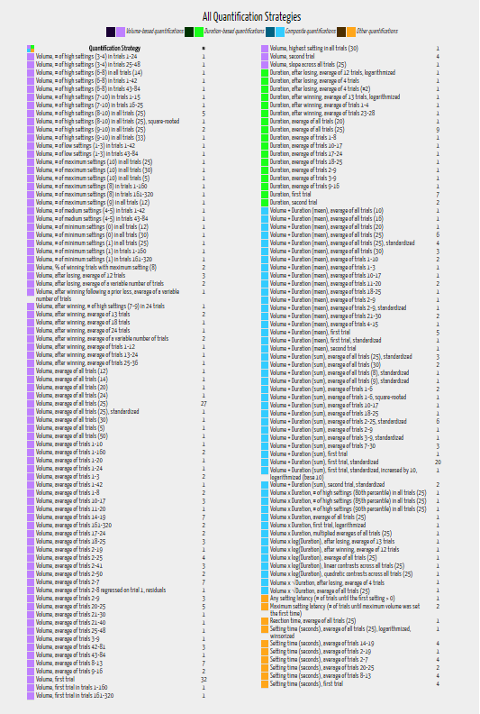

Slide 34
a bigger multiverse
a multiverse analysis shows a small part only of a larger multiverse of statistical results
there is not only a data multiverse but also a model multiverse
which control variables/covariates to include?
with or without interactions?
which likelihood to use?
which prior to use?

Slide 35
is there an association between serum levels of vitamin D and mortality (patel, burford, ioannidis, 2015)?
which adjustment variables to include in statistical models?
age; gender, and selection of 13 others
smoking, body mass index (BMI), hypertension, diabetes, cholesterol, alcohol consumption, education, income, family history of heart disease, heart disease, any cancer, physical activity and race/ethnicity
this gives rise to 2^13 = 8192 models
vibration effects due to model specification

Slide 36
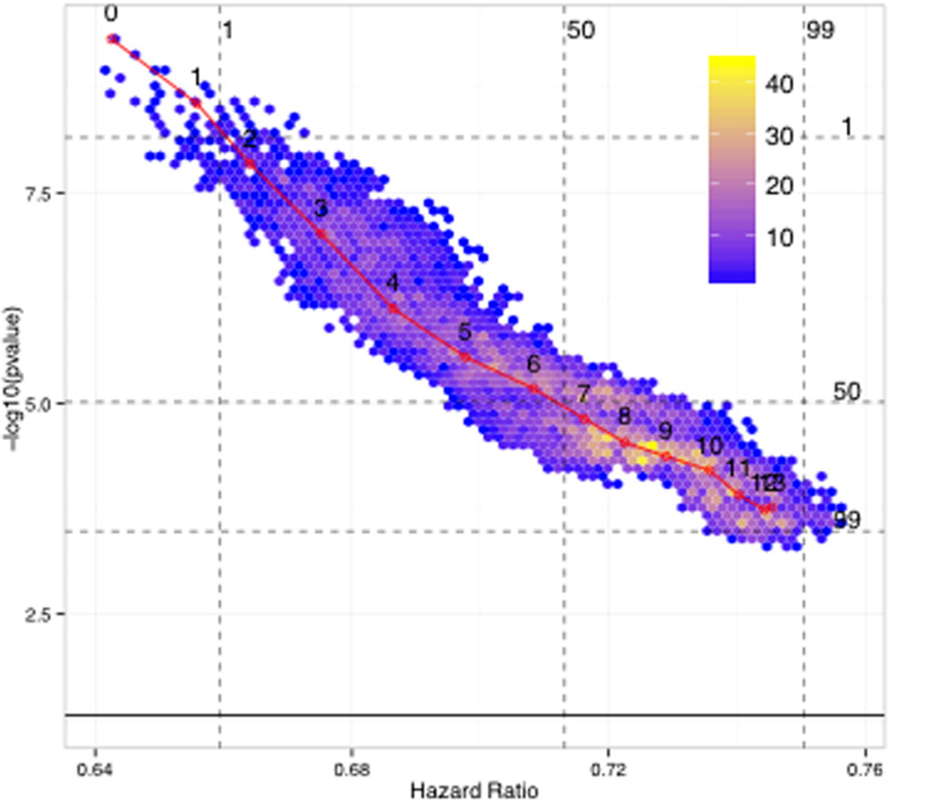

Slide 37
do hurricanes with more feminine names cause more deaths?
her-icanes are perceived as less threatening than him-icanes, leading people to engage in fewer precautionary measures (jung et al., 2014)
specification curve analysis (simonsohn, simmons, and nelson, 2016)
1728 results, based on different combinations of the following analysis decisions:
(1) which storms to include (e.g., extreme storms in terms of the predicted variable (deaths) or another variable (e.g., damage caused)
(2) operationalizing hurricane names’ femininity (continuous rating or binary)
(3) choosing covariates (property damages in dollars interacted with femininity; minimum hurricane pressure interacted with femininity; log of dollar damages; year; year interacted with damages)
(4) type of regression model (negative binomial regression, linear regression with log(deaths+1) as the dependent variable)
(5) functional form for femininity (interaction of femininity with damages; interaction of femininity with other hurricane characteristics (such as wind or category); main effect of femininity)

Slide 38
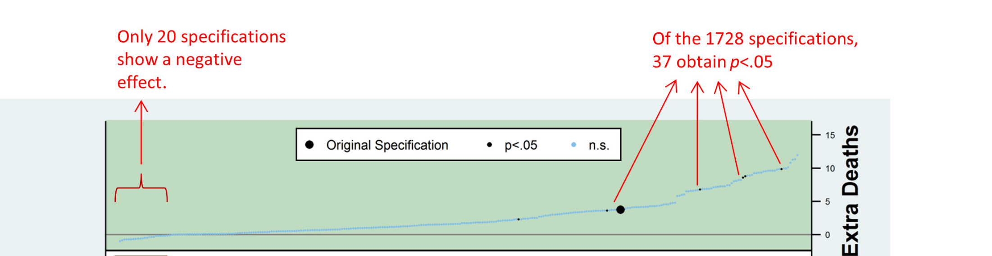
specification #, sorted by effect size

Slide 39
discussion
open data is part of the solution
when sharing your research data, share the raw data, not the processed data so that others can look at reasonable options you didn’t think of
thank you, kristina durante!
abandoning p-values is not a solution
a multiverse analysis is not restricted to p-values alone
e.g., Bayes factors as well are sensitive to choices in data construction

Slide 40
standardization is not a solution
if the standardization is merely a convention, then the robustness of a finding is still hidden
pre-registration of a single analysis is not a solution
it does prevent the exploitation of researcher degrees of freedom, but it still hides the robustness of the finding
unless the multiverse analysis is pre-registered

Slide 41
beyond robustness
robustness is not enough for an effect to be credible
is it reproducible?
same data, same analysis
is it replicable?
new data, same analysis
is it registered?
free of exploiting researcher degrees of freedom
with sufficient detail, adhered to

Slide 42

credibility of (some) findings can be tracked on the web platform curatescience.org
currently 1,058 replications of 168 effects from the cognitive and social psychology published literature

Slide 43
tracks, organizes, and evaluates replications of published findings in the social sciences
links to paper, data, research material, comments of original authors
checks reproducibility
checks robustness
checks registration
meta-analyzes all the available data
in the future: crowd sourced

Slide 44
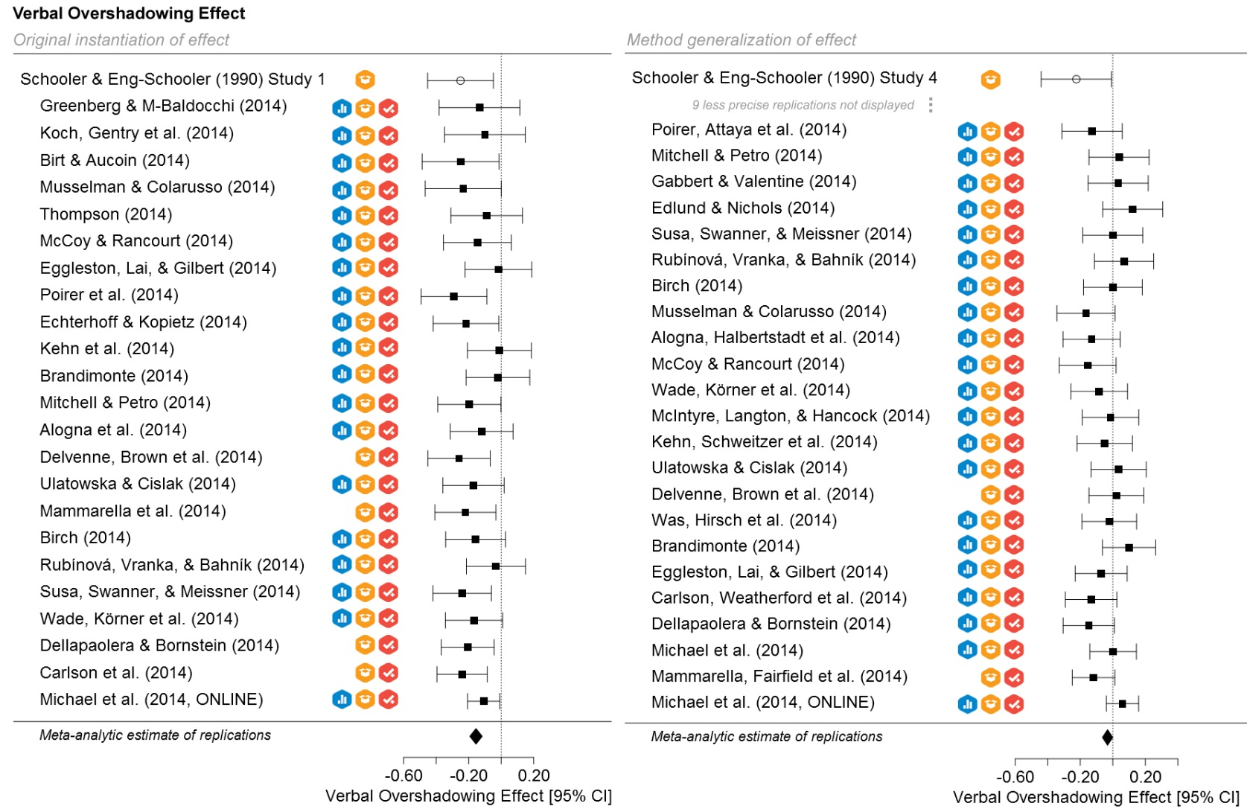

Slide 45
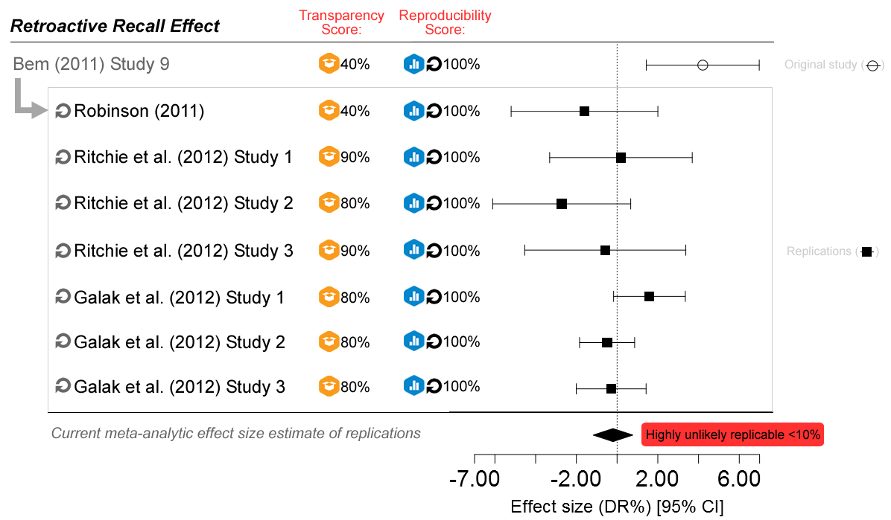

Slide 46
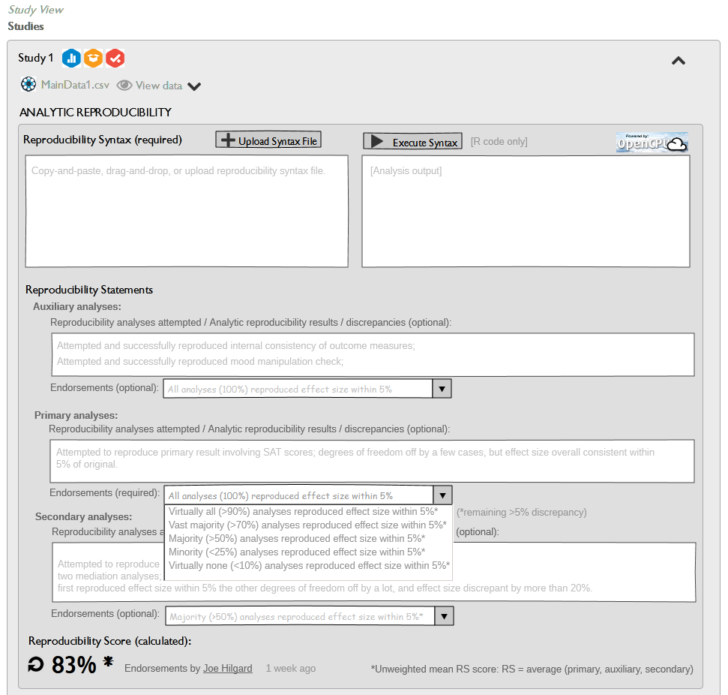

Slide 47
references
Durante, K. M., & Arsena, A. R. (2015). Playing the field: The effect of fertility on women’s desire for variety. Journal of Consumer Research, 41, 1372–1391.
Durante, K. M., Griskevicius, V., Cantú, S. M., & Simpson, J. A. (2014). Money, status, and the ovulatory cycle. Journal of Marketing Research, 51, 27–39.
Durante, K. M., Griskevicius, V., Hill, S. E., Perilloux, C., & Li, N. P. (2011). Ovulation, female competition, and product choice: Hormonal influences on consumer behavior. Journal of Consumer Research, 37 , 921–934.
Durante, K. M., Griskevicius, V., Simpson, J. A., Cantú, S. M., & Li, N. P. (2012). Ovulation leads women to perceive sexy cads as good dads. Journal of Personality and Social Psychology, 103 , 292–305.
Durante, K. M., Rae, A., & Griskevicius, V. (2013). The fluctuating female vote: Politics, religion, and the ovulatory cycle. Psychological Science, 24 , 1007–1016.
Gelman, A., & Loken, E. (2014). The statistical crisis in science. American Scientist, 102, 460–465.
Jung, K., Shavitt, S., Viswanathan, M., & Hilbe, J. M. (2014). Female hurricanes are deadlier than male hurricanes. Proceedings of the National Academy of Sciences, 111(24), 8782-8787.
LeBel, E. P., McCarthy, R., Earp, B. D., Elson, M., & Vanpaemel, W. (in press). A Unified Framework To Quantify The Credibility Of Scientific Findings. Advances in Methods and Practices in Psychological Science
Patel, C. J., Burford, B., & Ioannidis, J. P. (2015). Assessment of vibration of effects due to model specification can demonstrate the instability of observational associations. Journal of Clinical Epidemiology, 68 (9), 1046–1058.
Simmons, J. P., Nelson, L. D., & Simonsohn, U. (2011). False-positive psychology: Undisclosed flexibility in data collection and analysis allows presenting anything as significant. Psychological Science, 22 , 1359–1366.
Simonsohn, U., Simmons, J.P. , & Nelson, L. (2015)., Specification Curve: Descriptive and Inferential Statistics on All Reasonable Specifications . Available at SSRN
Wicherts JM, Veldkamp CL, Augusteijn HE, Bakker M, van Aert RC, van Assen MA. Degrees of freedom in planning, running, analyzing, and reporting psychological studies: a checklist to avoid p-hacking. Frontiers in Psychology. 7, 1832 (2016).

Slide 48
increasing transparency through a multiverse analysis
reference: steegen, s, tuerlinckx, f., gelman, a., & vanpaemel, w. (2016). increasing transparency through a multiverse analysis. perspectives on psychological science, 11, 702-712.
osf project page: https://osf.io/zj68b/ (code, data, slides, etc)
app: https://r.tquant.eu/KULeuven/Multiverse/
email : wolf.vanpaemel@kuleuven.be

